Slide 1
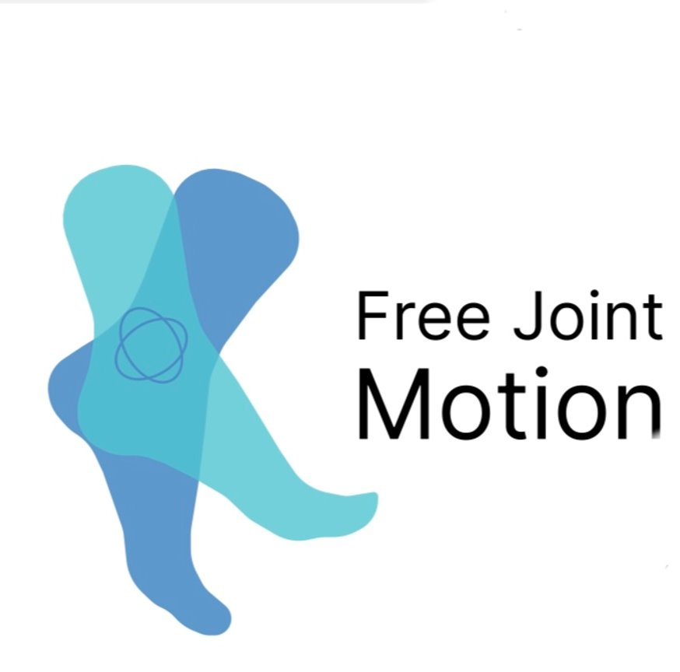
Developing Free Joint Motion
Team 7:
Kaylee Richter, Jon Wilner, Oluwaseun Aribo

Slide 2
Agenda
Industry Analysis
Cultural Impacts
Entering the Market
Product Pricing
Competitors pricing
Possible Joint Ventures and Grants
Key Findings
Final Recommendations

Slide 3
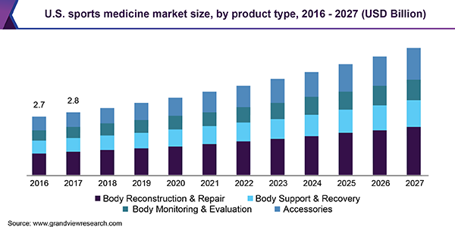
Sports Science Industry
History of Sports Science Market
Branch that focuses on treatment and prevention of injuries stemming from physical activity
1900's – various committees to monitor and improve
American College of Sports Medicine (ACSM), American Orthopedic Society for Sports Medicine
Athletic injury awareness is constantly growing
Notes:
Kaylee
https://www.northeastspineandsports.com/blog/the-history-of-sports-medicine/

Slide 4
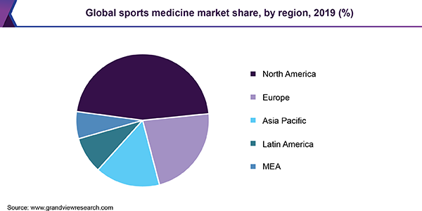
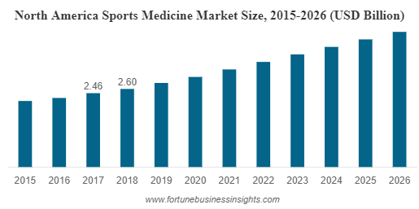
Sports Science Industry
Current Sports Science Market
$6.2 billion dollar industry worldwide
US Market - $8.5 million
Annual growth rate of 8.2%
Four segments to the industry
Major Names in the Industry
Arthrex
Smith and Nephew
Stryker
North American Market
Presence of well-developed healthcare
High spending and availability of technology advances
Notes:
Kaylee
https://www.northeastspineandsports.com/blog/the-history-of-sports-medicine/
https://www.grandviewresearch.com/industry-analysis/sports-medicine-industry

Slide 5
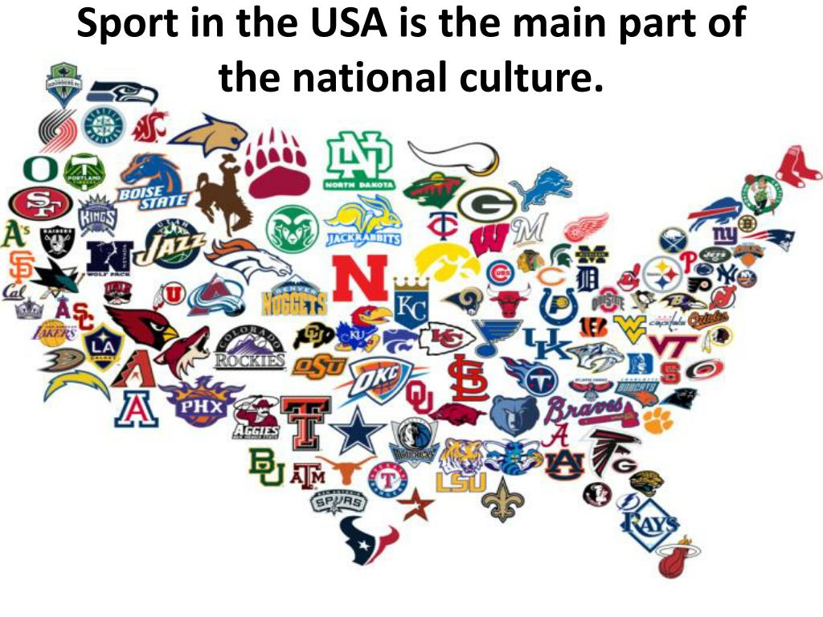
CAGE Analysis Impacts
Cultural Distance
Communication is a large part of the industry
Cultural emphasis on specific sports
American sports spreading to Brazil
Economic Distance
Access to funding
Access to recovery tools
Healthcare development
Notes:
Kaylee
https://thecampanile.org/2020/02/16/different-countries-place-cultural-emphasis-on-specific-sports/
https://thecampanile.org/2020/02/16/different-countries-place-cultural-emphasis-on-specific-sports/

Slide 6
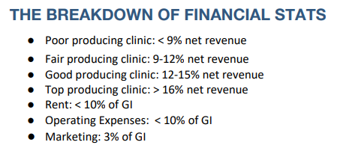
Market Entry Options
Universities
Use Athletic Training Rooms to advertise to incoming athletes
Large amounts of money to spend on Training Room and Athletic Facilities
$145 Million – University of Colorado
$66.5 million – Ohio State
$65.5 million – Ithaca College
Sports Clubs
Commonly used equipment
Weights
Endurance machines
Equipment is not frequently replaced
Endurance machines – 7 to 10 years
Strength Equipment – 10 to 15 years
Rehab Centers
Limited Disposal costs
Low profit margin
Other expensive equipment that cannot be substituted
Notes:
1FB60FE7-5056-A04E-371B71A3FD1B4F08.pdf (ppsapta.org)
The 10 Commonly Used Commercial Gym Equipment | Fitness Expo (fitnessexpostores.com)
https://www.clubindustry.com/sponsored/how-to-maximize-your-equipment-investment#:~:text=Although%20it%20varies%20by%20facility,lasts%2010%20years%20or%20more.
https://www.stack.com/a/expensive-college-athletic-training-facilities/

Slide 7



Universities Currently Completing Studies
Popular areas of study for sports medicine: Sports ethics, Sports psychology, Sports nutrition
Top sports medicine schools=Division 1 schools, studies on athletes
Loma Linda University Health study
Notes:
JON
TARGET SCHOOLS DOING STUDIES
Researchers from LLU identified an alternative approach to help clinicians examine and treat patients with chronic lateral ankle sprains and instability. They found that muscular impairments in the hip are associated with abnormal movement patterns in those individuals with chronic ankle sprains.

Slide 8




Potential Partners
Athletic Training Room Designer Companies
Offering promotions and advertising on campus to student athletes and sports medicine
Have student athlete ambassadors market products through social media
Reach out to student athletes to promote products
Create a social media presence around schools that have a big athletic presence
Subscription based software updates
Notes:
JON

Slide 9



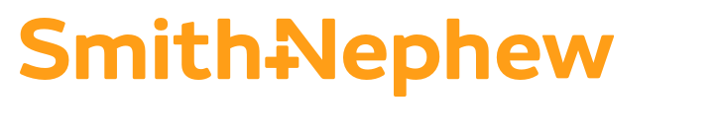
Major Competitors
ELGIN $1000+
BIODEX average price $18000
MEDISPORT $1000+
Smith and Nephew $6400+
Notes:
JON
Add in notes what differentiate competitors from free joint
TOP 5 COMPETITORS
ELGIN: product is roughly 5k cheaper not as advanced as Free Joint Motion. Not computerized, not as intuitive, rotating motion on a platform
BIODEX: costly, powered by windows 10 not own software, touchscreen, can help other parts below the hip area
MEDISPORT: Computer is built into the device, not as intuitive as free joint motion, MEDSLIPPER supports Articular and muscular contusions, Fractures, Muscle sprains
SMITH AND NEPHEW: Simple to use, military grade quality, ergonomic design, can help message hip

Slide 10
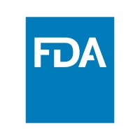
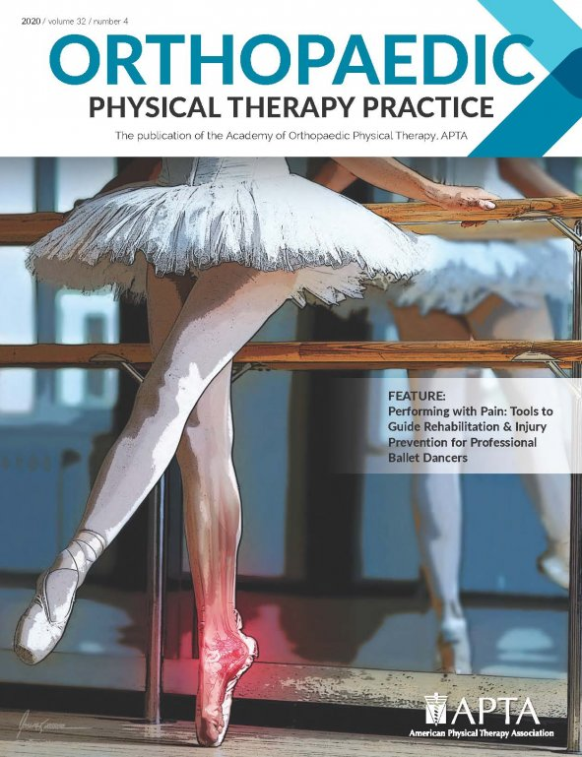
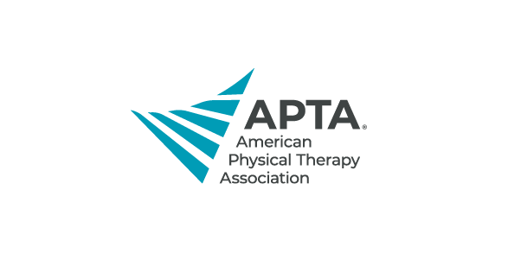
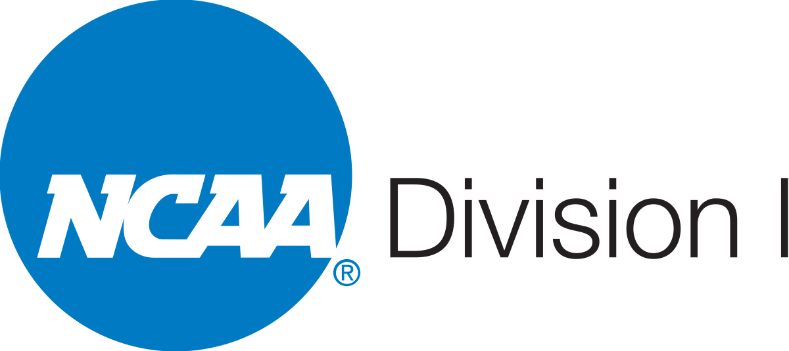
Regulations
FDA regulations
NCAA regulations
Foot and Ankle Special Interest Group Guidelines
American Physical Therapy Association
Notes:
JON
To sell medical devices in the U.S it is an 11 step process
Some important aspects to look at are
Determine the classification of the medical device (what class of the device does it fall in class 1,2 or 3)
What clinical studies are required
After deciding what class the device is in each class has its own procedures and documents that need be followed through
Follow the compliance of the FDA and QUALITY AND SAFETY REVIEW
Follow the state guidelines if designated state does not have regulations regarding medical device then seek federal agent representative to stay compliant and in contact with FDA
Register the device on the FDA WEBSITE
If future designs and changes are made have to do it through the FDA site

Slide 11
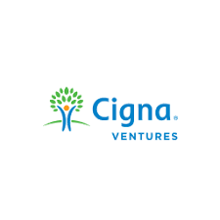

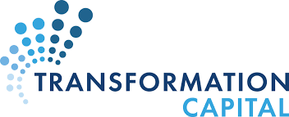

Collaboration with Venture Capitalists
Possible Venture Capitalist Companies
ADQ
Bond
Founders Fund
General Catalyst
Green Innovations
Khosla Ventures
Notes:
Large Amounts of Capital Can Be Raised. ...
Can Provide Risk Management Support. ...
No Monthly Payments. ...
Personal Assets Don't Need To Be Pledged
These are a few venture capitalist that are involved sport therapy.
These companies partner with entrepreneurs who share the same vision to unlock opportunities to improve people's health.

Slide 12

Grant Possibilities
The AOSSM Research Mission
To enhance value in sports medicine through the development, promotion, and encouragement of cutting-edge research that improves patient care.
The AOSSM Grants
Playmaker Grant
Sandy Kirkley Clinical Outcomes Research Grant
Osteoarthritis Research Grant
Return to Play Clinical Research
Notes:
There are few grant opportunities:
Playmaker Grant: This research grant of up to $50,000 total aims to help fund ambitious, exploratory, and ground-breaking projects in orthopaedic sports medicine. Criteria and metrics utilized in the proposed study must be determined by the best scientific evidence and designed to improve the understanding of emerging or novel technology in orthopaedic sports medicine. Studies involving human subjects will receive priority.
Return to play: This grant offers up to $150,000 to support a clinical research project investigating a return to play after musculoskeletal injury.

Slide 13
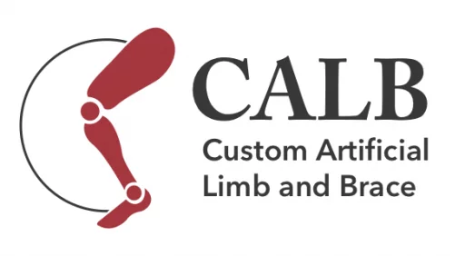


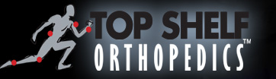
Collaboration with Manufactures
Possible Manufactures
CUSTOM ARTIFICIAL LIMB & BRACE
SHELF MANUFACTURING, LLC
ANATOMICAL CONCEPTS INC
Notes:
ANATOMICAL CONCEPTS INC:
These companies help custom Manufacture of orthopedic bracing and supports.
Products include knee braces, patella stabilizers, ankle supports, shoulder immobilizers, arm slings, spine bracing, CPM pads, cold therapy equipment, hand and wrist supports.

Slide 14
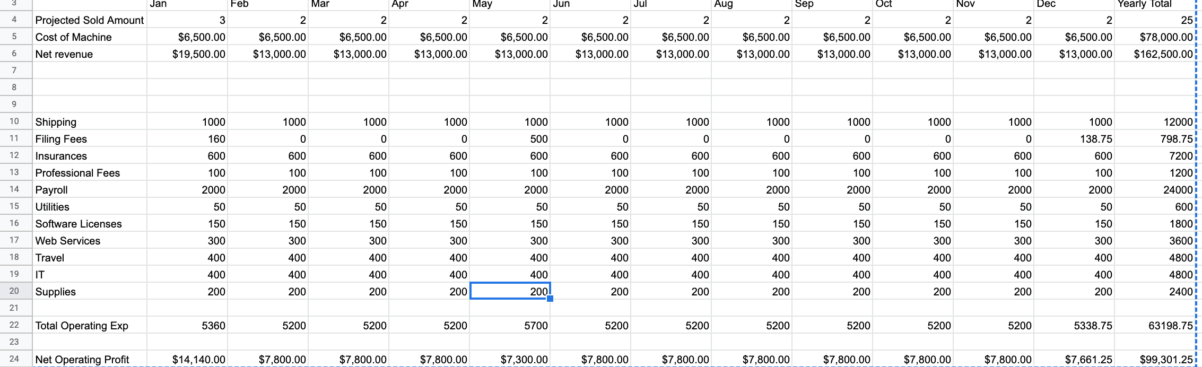
Pricing Model
Notes:
- make estimates on what the us costs would be launching in the US
- if you can do this the first year --- this would be the outcome
- cash flow estimate for them to play with
- funding amount

Slide 15
Key Findings
Sports Medicine Industry is rapidly growing
Universities have the most disposable income
Various regulations to follow pertaining ankle support products in universities
Need to advertise and market the product from sports studies to student athletes
Various grant and joint ventures opportunities
Notes:
Jon

Slide 16
Final Recommendations
Go after Universities!!
Promoting products within
Clinical studies and research to improve design
Offer subscription-based updates and improvements
Find a partner to leverage relationships
Partner, Software Company
Apply for Grants, Venture Capitalists
Follow FDA 11 step process to sell medical devices in the U.S
Notes:
Jon

Slide 17
Thank you!

